Slide 1
BORDER ISSUES INVOLVING REFUGEE CLAIMS
Northern Border Conference
Presented by Samuel Plett
Friday, October 19th, 2018
Notes:
• Each slide was designed using MASTER SLIDES.
• Create new slides using the existing master slides and then modify accordingly
• Fonts to be used: ARIAL

Slide 2
OVERVIEW
The reason for “irregular arrival” of refugee claimants: the legal framework and the Safe Third Country Agreement (‘STCA’)
Proving an exception to the STCA at Port-of-Entry
Discussion of DNA tests to establish family member relationships for the purposes of the STCA (tips and best practices)
Notes:
• Each slide was designed using MASTER SLIDES.
• Create new slides using the existing master slides and then modify accordingly
• Fonts to be used: ARIAL

Slide 3
How many irregular border crossings lead to refugee claims?
IRB has published statistics on “irregular border crossings” – available online at: https://irb-cisr.gc.ca/en/statistics/Pages/Irregular-border-crosser-statistics.aspx
Notes:
• Each slide was designed using MASTER SLIDES.
• Create new slides using the existing master slides and then modify accordingly
• Fonts to be used: ARIAL

Slide 4
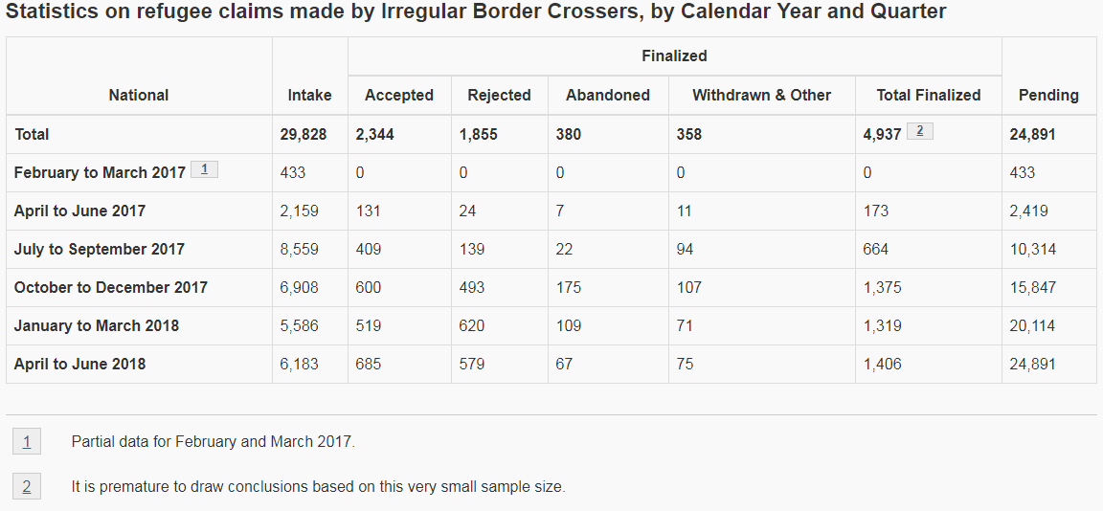
How many irregular border crossings lead to refugee claims?
Notes:
• Each slide was designed using MASTER SLIDES.
• Create new slides using the existing master slides and then modify accordingly
• Fonts to be used: ARIAL

Slide 5
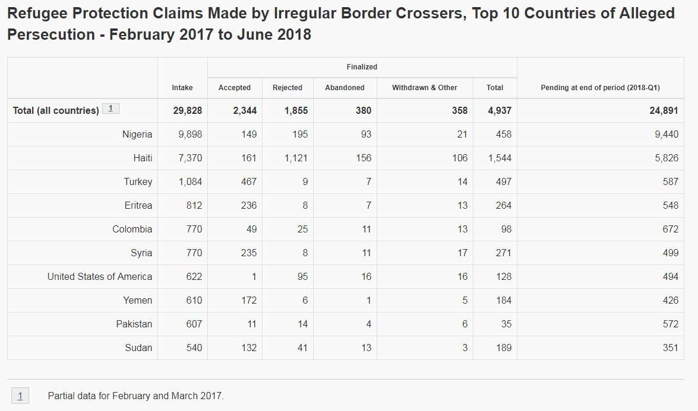
How many irregular border crossings lead to refugee claims?
Notes:
• Each slide was designed using MASTER SLIDES.
• Create new slides using the existing master slides and then modify accordingly
• Fonts to be used: ARIAL

Slide 6
Why not make a refugee claim at the poe?
Potential claimants seeking entry by land from the United States are prima facie ineligible to apply at port-of-entry
IRPA para 101(1)(e)
Ineligibility
101 (1) A claim is ineligible to be referred to the Refugee Protection Division if
…
(e) the claimant came directly or indirectly to Canada from a country designated by the regulations, other than a country of their nationality or their former habitual residence; or
Notes:
• Each slide was designed using MASTER SLIDES.
• Create new slides using the existing master slides and then modify accordingly
• Fonts to be used: ARIAL

Slide 7
Why not make a refugee claim at the poe?
Currently, the United States is the only country designated under the Regulations – see ss. 159-159.7; designation at s. 159.3 of Regulations
Canada and the United States are parties to the Agreement dated December 5, 2002 between the Government of Canada and the Government of the United States of America for Cooperation in the Examination of Refugee Status Claims from Nationals of Third Countries (referred to as Safe Third Country Agreement or STCA) – available online: https://www.canada.ca/en/immigration-refugees-citizenship/corporate/mandate/policies-operational-instructions-agreements/agreements/safe-third-country-agreement/final-text.html
Notes:
• Each slide was designed using MASTER SLIDES.
• Create new slides using the existing master slides and then modify accordingly
• Fonts to be used: ARIAL

Slide 8
Why not make a refugee claim at the poe?
STCA provides that, subject to a list of enumerated exceptions, persons must file for asylum in “country of last presence” (country to which the claimant first travelled)
Exceptions are provided for in Article 4 of STCA (see text in materials)
Notes:
• Each slide was designed using MASTER SLIDES.
• Create new slides using the existing master slides and then modify accordingly
• Fonts to be used: ARIAL

Slide 9
Why not make a refugee claim at the poe?
NOTE: STCA does not apply to U.S. citizens seeking to file a claim against the U.S. (s. 159.2 of Regulations)
STCA only applies to claims made at the port-of-entry
Non-application — ports of entry other than land ports of entry
159.4 (1) Paragraph 101(1)(e) of the Act does not apply to a claimant who seeks to enter Canada at
(a) a location that is not a port of entry;
(b) a port of entry that is a harbour port, including a ferry landing; or
(c) subject to subsection (2), a port of entry that is an airport.
Notes:
• Each slide was designed using MASTER SLIDES.
• Create new slides using the existing master slides and then modify accordingly
• Fonts to be used: ARIAL

Slide 10
Why not make a refugee claim at the poe?
Once a person is in Canada, they cannot be removed without an assessment of the risk they would face upon removal – duty of non refoulement
Principle of Non-refoulement
Protection
115 (1) A protected person or a person who is recognized as a Convention refugee by another country to which the person may be returned shall not be removed from Canada to a country where they would be at risk of persecution for reasons of race, religion, nationality, membership in a particular social group or political opinion or at risk of torture or cruel and unusual treatment or punishment.
Notes:
• Each slide was designed using MASTER SLIDES.
• Create new slides using the existing master slides and then modify accordingly
• Fonts to be used: ARIAL

Slide 11
Why not make a refugee claim at the poe?
Once a refugee claim is made within Canada, an officer must assess whether the claim is eligible; and, if eligible, must refer the claim to the Immigration and Refugee Board [IRPA s. 99(3); 100(1)]
A refugee claim must be made prior to the issuance of a removal order [IRPA s. 99(3)]
Notes:
• Each slide was designed using MASTER SLIDES.
• Create new slides using the existing master slides and then modify accordingly
• Fonts to be used: ARIAL

Slide 12
When is a person considered to be “arriving” at POE?
NOTE: cited from IRCC guidelines at: https://www.canada.ca/en/immigration-refugees-citizenship/corporate/publications-manuals/operational-bulletins-manuals/refugee-protection/canada/processing-claims-protection-safe-third-country-agreement.html
The Agreement is not applicable to claimants who enter between ports of entry (R159.4). A land border port of entry is any designated land port of entry as in Schedule 1 of the Regulations.
“Arrival” at a land border port of entry generally includes persons:
presenting themselves for inspection at a port of entry
coming or attempting to come into the country through a port of entry (whether or not they present themselves for inspection)
apprehended or continuously observed crossing the land border by a port official, within the physical boundaries of the port or in the immediate vicinity of the port.
Notes:
• Each slide was designed using MASTER SLIDES.
• Create new slides using the existing master slides and then modify accordingly
• Fonts to be used: ARIAL

Slide 13
When is a person considered to be “arriving” at POE?
NOTE: cited from IRCC guidelines at: https://www.canada.ca/en/immigration-refugees-citizenship/corporate/publications-manuals/operational-bulletins-manuals/refugee-protection/canada/processing-claims-protection-safe-third-country-agreement.html
(CONT’D)
Note: Occasionally a person may attempt to avoid examination at the POE. The Agreement is only applicable if port of entry officials observe or detect the person in the act of attempting to avoid examination and the person is apprehended immediately within the vicinity of the POE. If the person is apprehended inland at a later date, the person cannot be returned to the U.S.A. pursuant to the Agreement.
Notes:
• Each slide was designed using MASTER SLIDES.
• Create new slides using the existing master slides and then modify accordingly
• Fonts to be used: ARIAL

Slide 14
When can a refugee claim be made at US-Canada poe? Exceptions to stca
Useful References
CBSA guidelines on STCA at: https://www.cbsa-asfc.gc.ca/agency-agence/stca-etps-eng.html#b4
IRCC guidelines on STCA at: https://www.canada.ca/en/immigration-refugees-citizenship/corporate/publications-manuals/operational-bulletins-manuals/refugee-protection/canada/processing-claims-protection-safe-third-country-agreement.html
Notes:
• Each slide was designed using MASTER SLIDES.
• Create new slides using the existing master slides and then modify accordingly
• Fonts to be used: ARIAL

Slide 15
When can a refugee claim be made at US-Canada poe? Exceptions to stca
See Article 4 of STCA; s. 159.5 of Regulations
Family member in Canada who is
a Canadian citizen; PR; protected person; or under stay of removal
has made a refugee claim that has been referred to IRB
the holder of a work permit/study permit (with exceptions)
“family member, in respect of a claimant, means their spouse or common-law partner, their legal guardian, and any of the following persons, namely, their child, father, mother, brother, sister, grandfather, grandmother, grandchild, uncle, aunt, nephew or niece.”
Notes:
• Each slide was designed using MASTER SLIDES.
• Create new slides using the existing master slides and then modify accordingly
• Fonts to be used: ARIAL

Slide 16
When can a refugee claim be made at US-Canada poe? Exceptions to stca
See Article 4 of STCA; s. 159.5 of Regulations
Document holder [see list at 159.5 (f)]
Visa exempt persons [see 159.5(g)]
Persons who are “seeking to re-enter Canada in circumstances where they have been refused entry to the United States without having a refugee claim adjudicated there” [see 159.5(h)]
Notes:
• Each slide was designed using MASTER SLIDES.
• Create new slides using the existing master slides and then modify accordingly
• Fonts to be used: ARIAL

Slide 17
When can a refugee claim be made at US-Canada poe? Exceptions to stca
5. “Public interest” exception (Article 6 of STCA)
s. 159.6 of Regulations - STCA does not apply where the claimant has been charged/convicted of an offence punishable by death penalty (in U.S. or elsewhere)
Notes:
• Each slide was designed using MASTER SLIDES.
• Create new slides using the existing master slides and then modify accordingly
• Fonts to be used: ARIAL

Slide 18
Exceptions to stca: standard of proof
STCA Statement of Principles
Proof of Family Relationship. Procedures will acknowledge that the burden of proof is on the applicant to satisfy the decision-maker that a family relationship exists and that the relative in question has the required status. Credible testimony may be sufficient to satisfy a decision-maker in the absence of documentary evidence or computer records. It may be appropriate in these circumstances to request that the applicant and the relative provide sworn statements attesting to their family relationship.
Standard for Determining Eligibility for an Exception to the Agreement. The United States will use the preponderance of evidence standard to determine whether an applicant qualifies for an exception under the Agreement. Canada will use the balance of probabilities standard to determine whether an applicant qualifies for an exception under the Agreement. These standards are functionally equivalent.
Notes:
• Each slide was designed using MASTER SLIDES.
• Create new slides using the existing master slides and then modify accordingly
• Fonts to be used: ARIAL

Slide 19
Exceptions to stca: standard of proof
Key issues:
Credibility of original documents presented to prove relationship (‘security features’)
Consistency of testimony between claimant and ‘anchor relative’
Corroborating evidence, such as: affidavits for third parties; photographs of relatives together; proof of contact; DNA test results, etc.
Notes:
• Each slide was designed using MASTER SLIDES.
• Create new slides using the existing master slides and then modify accordingly
• Fonts to be used: ARIAL

Slide 20
Exceptions to stca: DNA TEsting
Recall: standard of proof is balance of probabilities
If dealing with a reconsideration request, consider coordinating with the Superintendent at POE
Follow the general IRCC guidelines for DNA testing (with necessary modifications): https://www.canada.ca/en/immigration-refugees-citizenship/corporate/publications-manuals/operational-bulletins-manuals/standard-requirements/dna-testing.html
Only use laboratories certified by Standards Council of Canada: https://www.scc.ca/en/search/palcan/dna
Notes:
• Each slide was designed using MASTER SLIDES.
• Create new slides using the existing master slides and then modify accordingly
• Fonts to be used: ARIAL

Slide 21
Exceptions to stca: DNA TEsting
Take steps to ensure chain of evidence is preserved
Have results mailed directly from lab to POE (coordinate with superintendent)
Ensure that neither claimant nor family member have any control over sample at any time, including:
Take package unopened to medical facility
Ensure that only the test taker ever touches the sample
Ensure that photograph is taken by (or provided to) the test taker
Document every step taken
Notes:
• Each slide was designed using MASTER SLIDES.
• Create new slides using the existing master slides and then modify accordingly
• Fonts to be used: ARIAL

Slide 22
QUESTIONS?
Notes:
• Each slide was designed using MASTER SLIDES.
• Create new slides using the existing master slides and then modify accordingly
• Fonts to be used: ARIAL

Slide 23
Samuel Plett
647-776-3915 69 YONGE STREET, SUITE 700 splett@desloges.ca TORONTO, ON M5E 1K3
Notes:
• Each slide was designed using MASTER SLIDES.
• Create new slides using the existing master slides and then modify accordingly
• Fonts to be used: ARIAL

