Slide 1
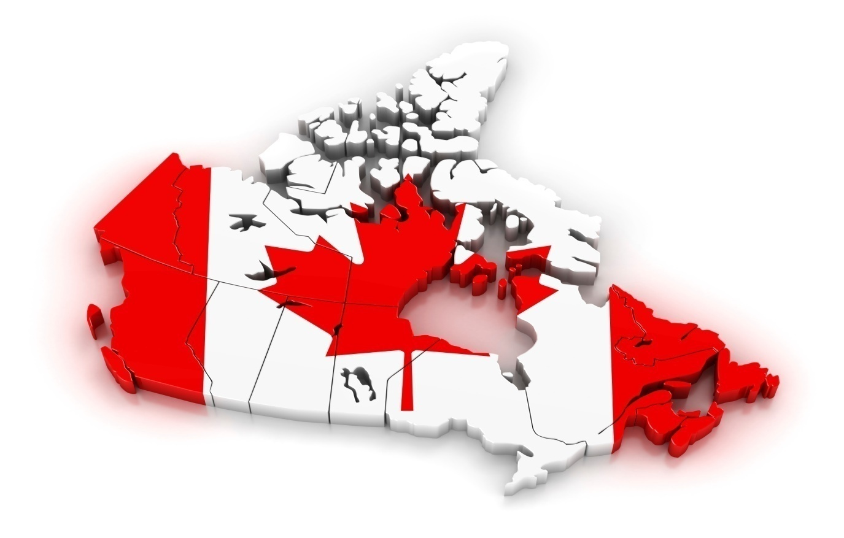
“PUFF THE MAGIC DRAGON”
THE LONG LONG ARM OF THE LAW - ETHICAL AND CROSS BORDER ISSUES ARISING FROM CANADA’S LEGALISATION OF CANNABIS AND THE VARIOUS PRIVACY REGIMES THAT PERTAIN
THEODORE GOLOFF ESQ,
ROBINSON SHEPPARD SHAPIRO LLP
NIAGARA ON THE LAKE – OCTOBER 19, 2018

Slide 2
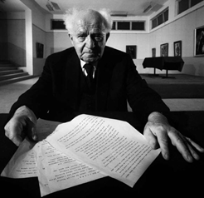
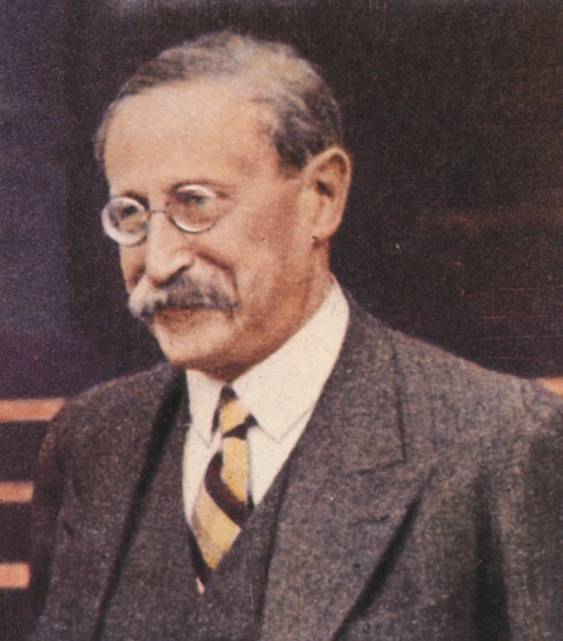
Léon Blum
+
+
David Ben-Gurion
IN LAW, LIKE IN GEOGRAPHY, WHERE YOU BEGIN DETERMINES WHERE YOU END!

Slide 3
« D’abord, je suis humaniste, ensuite je suis un socialiste, et c’est en dernier que je suis un juif »
(Attributed to Léon Blum, Prime Minister of France,Third Republic)
« Formidable M. le Premier Ministre, parce que comme vous savez, l’hébreu se lit de droite à gauche »
(Attributed to David Ben-Gurion, First Prime Minister of Israël)

Slide 4
Point of Departure
The geographic proximity of Canada to the United States , the intertwined and interdependent nature of their respective economies, the commonalities of language and history, the subtlety of the crucial differences between the American and Canadian constitutional and judicial systems and approaches to privacy and human rights law, coupled with, at times, aggressive and robust attempts to “long-arm” protections afforded by laws from both sides of the border has led or might be expected to lead to tension, and sometimes litigation.

Slide 5
It was said by McLachlin J., as she was then in, Terry vs. The Queen, [1996], 2 S.C.R. 207, at par. 16, citing Tolofson vs. Jensen:
“Ordinarily, people expect their activities to be governed by the law of the place where they happen to be and expect that concomitant legal benefits and responsibilities will be defined accordingly. The government of that place is the only one with the power to deal with those activities. The same expectation is ordinarily showed by other states and by people outside the place where an activity occurs.”
(Underlines, our own)

Slide 6
Apparently the “benefits” of cannabis legalisation in Canada may not translate so well when crossing the border!
Apparently U.S.C.B.P. officers are authorized to inspect “all persons, baggage and merchandise arriving in the Customs territory of the United States from places outside thereof… “ unless exempt by diplomatic status (19 CFR 162.6);
Apparently cannabis remains a Schedule 1 drug pursuant to the Controlled Substances Act, 84 Stat 1242;

Slide 7
Apparently, amongst « Classes of Aliens » ineligible for admission to the U.S., include “aider, abettor, assister, conspirator or colluder in the illicit trafficking in any… [Schedule 1]… substance… or endeavored to do so” (8 U.S.C., 1182, Sect. 212);
For impact, see Addendum;
Recognizing that entry to the U.S. for a citizen of a foreign country is a privilege, not a right, is the impact a form of “long arm” application into Canada of U.S law?

Slide 8
« Sovereignty », «Sovereign Equality » and « Comity »
While “…As a general rule, Canadians abroad are bound by the law of the country in which they find themselves and cannot avail themselves of their rights under the Charter”, no doubt in response to stressor agents that the phenomenon of the “Global Village” may present, none of the doctrines, of “sovereign equality”, “comity” or otherwise, seem to have limited Quebec or Canadian legislators in incremental extra-territorial extension of some statutes or rights andparticularly the Canadian and/or Quebec Charters to make them apply, in whole or in part, beyond its borders.
Canada (Prime Minister) vs. Khadr, [2010] 1 S.C.R. 44; par. 14;

Slide 9
How legislation impacts or may be expected to impact in specific areas, activities and situations is as much a function of how and why the legislation was adopted, its place and context within the hierarchy of laws and statutes that govern and the approach and internal dynamic of the tradition concerned, as it is of the specific statutory texts themselves.
This is no less evident in the extraterritorial reach of some of some aspects of the Quebec Privacy Regime. The very different origin of the approach to privacy law in Quebec makes the impact, actual or potential of its privacy regime on the employment law landscape in Quebec quite distinct.
In Quebec, the “privacy regime” in the private sector is composed of i) Quebec’s Act Respecting Protection of Personal Information in the Private Sector, L.R.Q. c. P-39.1; ii) Act to Establish a Legal Framework for Information Technologies; R.S.Q. c. C-1.1, and particularly Sections 23-27, 34, 37, 4041, 44-46 thereof governing inter alia the use and storage of biometric data; iii) Arts. 3, 35-41 C.C.Q.; and Art. 5, Charter of Rights and Freedoms, L.R.Q. c. C-12;

Slide 10
On the other hand, the Canada Charter and the Quebec Charter, and indeed other constitutional or quasi-constitutional domestic Canadian legislation may impact on how “international” business relationships are or may be ordered.
Our Supreme Court determined that in respect of the Canada Charter and in making banking arrangements, in particular but not limitatively, “….a Canadian residing in a foreign country should expect his or her privacy to be governed by the laws of that country and as such, a reasonable expectation of privacy will generally correspond to the degree of protection those laws provide.”

Slide 11
Privacy legislation in Canada- Overview
Federal Government and Three Provinces Have Adopted Full Blown Privacy Statute Substantially Similar to “Pipeda”:
Personal Information Protection and Electronic Documents Act 2000, R.S.C., C-5.;
British Columbia Privacy Act, RSBC 1996, c. 373; Freedom of Information and Privacy Act, RSBC 1996, c. 165; E-Health (Personal Health Information Access and Protection of Privacy Act, SBC 2008;
Alberta Freedom of Information and Protection of Privacy Act, RSA 2000, c. F-25;
R.S.Q., c. C-12, as amended;
Act Respecting Protection of Personal Information in the Private Sector, L.R.Q. c. P-39.1 (hereinafter “ARPIPPS”); ii) Act to Establish a Legal Framework for Information Technologies; R.S.Q. c.
C-1.1, and particularly Sections 23-27, 34, 37, 4041, 44-46 thereof governing inter alia the use and storage of biometric data; iii) Arts. 3, 35-41 C.C.Q.; and Art. 5,
Charter of Rights and Freedoms, L.R.Q. c. C-12; L.R.Q. c. P-39.1 as amended;
Quebec’s regime is not designed to create “safe harbor” as a response to E.U. legislation but is an outgrowth of recognized rights of privacy.

Slide 12
Other Provinces – Ontario, New Brunswick, Newfoundland and Labrador and Nova Scotia have health data related statutes;
Personal Health Information Protection Act, 2004, S.O. 2004, c.3;
Personal Health Information Pravaeyond Access Act, S.N.B. 2009, c. P-7.05;
Personal Health Information Act, S.N.L. 2008, Chapter P-7.01;
Personal Health Information Act, as amended S.N.S. 2010, Chapter 41;

Slide 13
However
When it adopted its own Charter of Rights and Freedoms in 1975, distinct from the Canada Charter, Quebec articulated therein not only fundamental guarantees against discrimination in myriad forms. It also created a constitutionally guaranteed right of privacy composed of both the right to the safeguard of a person’s dignity, honor and reputation and his right to the respect of his private life.
The quasi-constitutional status of the Quebec Charter and its provisions, including the Charter enshrined rights of privacy and the right to be free of discrimination in their myriad forms, helped to define the juridical framework within which the legality of quite a number of employer decisions or actions came to be appreciated and then decided and this both before and after the Quebec Privacy Regime in the Private Sector came into being.

Slide 14
The impact of right of privacy is also conditioned by Article 46 of the Quebec Charter setting forth that: “every person who works has a right, in accordance with the law, to fair and reasonable conditions of employment which have proper regard for his health, safety and physical well-being”.
The Civil Code provides:
“The Civil Code comprises a body of rules which, in all matters within the letter, spirit or object of its provisions, lays down the jus commune, expressly or by implication. In these matters, the Code is the foundation of all other laws, although other laws may compliment the Code or make exceptions to it.”
Art. 3 of C.C.Q. provides:
“Every person is the holder of personality rights, such as the right to life, the right to the inviolability and integrity of his person and the right to the respect of his name, reputation and privacy. ”
These rights are inalienable” (Underlines our own)

Slide 15
The Code continues at Arts. 35 to 41 to legislate with respect to privacy. Amongst other things, the Code, at Art. 36 sets out what are to be considered as invasions of privacy including intercepting private communications or keeping a person’s private life under observation. Arts. 37 to 40 deal with various aspects of collection of information, examination, correction and/or rectification of information, items of course specifically dealt with in ARPPIPS. Art. 41 C.C.Q. provides:
“Where the law does not provide the conditions and modalities of exercise of the right of examination or rectification of a file, the Court upon application determines them.” (Underlines our own)
The practical effect of all of this is that where issues of privacy law including cyber- security arise, account must be taken not only of the provisions of the specific Act that applies, ARPPIPS in the private sector, but also of the Civil Code.

Slide 16
The branch plant economy is as well known in Quebec as it is in other
parts of Canada – perhaps more so! Firms doing business in Quebec but holding, using
or communicating information about its Quebec employees outside the province, are,
pursuant to Art. 17, not outside the statute’s reach. Bear in mind as well, that the term
“carrying on an enterprise in Quebec” does not necessarily require that there be a
physical plant in Quebec. Many firms may chose to use commission salesmen to
represent them in the province, providing some minimal communications equipment
and using the employee’s primary residence as its Quebec office. Such enterprises
would not be beyond reach of ARPPIPS. Furthermore, while the definition of
“enterprise” as given by Art. 1525 C.C.Q. requires that there be “an organized
economic activity” it need not be commercial in nature. The carrying on of the
enterprise may be periodic and need not be continuous. Traditional “bricks and
morter” are decidedly not required. For instance, in Institut d’Assurance du Canada vs.
Guay, 1998 C.A.I. 431, the fact that the Insurance Institute of Canada produces and
sells course manuals and material, and administers and corrects insurance exams in
Quebec, periodically renting space on an as needed basis, for the administration of
these exams, was deemed sufficient to attract the application of ARPPIPS.

Slide 17
While B.C.’s legislation has given rise to litigation regarding impact of Patriot Act on personal information exported for manipulation in U.S., B.C’s legislation, like Alberta’s or the PIPEDA does not have any long-arm provision, Quebec’s Statute does.
ARPPIPS has a “long-arm reach” to its application. It may be said to have an extra-territorial dimension, in that Art. 17 thereof provides:
“Every person carrying on an enterprise in Quebec who communicates, outside Quebec, information relating to persons residing in Quebec or entrusts a person outside Quebec with a task of holding, using or communicating such information on his behalf, must take all reasonable steps to insure:
That the information will not be used for purposes not relevant to the object of the file or communicated to third persons without the consent of the persons concerned, except in cases similar to those described in Sections 18 and 23;
In the case of nominative lists, that the persons concerned have a valid opportunity to refuse the personal information concerning them be used for purposes of commercial or philanthropic prospection and, if need be, to have such information deleted from the list.” (Underlines, our own);
This can have important consequences.

Slide 18
While the aforesaid Article 17 has not generated significant litigation as yet in Quebec, issues, in fact, did arise in British Columbia regarding possible unannounced F.B.I. intrusion into data held in the U.S. via the Patriot Act.
To what extent does such obligation require pre-screening of the possible conflict between whatever privacy legislation is involved, and overriding “intrusive” legislation of whatever countries such information is being forwarded to. British Columbia is home to a large number of Sikhs, while Quebec is home to a large Muslim and Arab populations. Does transference of the data to India or Israel, both highly security conscious countries, for clearly legitimate reasons, involve particular problems both for the “exporter” or the “importer” of sensitive data?

Slide 19
The obligation to take “all reasonable steps” to ensure compliance with Arts. 17(1) and (2) of ARPPIPS applies to persons “carrying on an enterprise”. Hence, the obligation is not only on the enterprise itself, but equally on the person carrying on such enterprise. In the case of a legal person, this responsibility may go beyond the directors of the “enterprise”. To be sure, the obligation arises when, at the time the person outside Quebec is “entrusted” with the task of holding, using or communicating such information, but when does it end ? If it is ongoing and it attaches to parties other than the “enterprise” itself, when is the obligation extinguished? What constitutes “all reasonable steps”?
The concentration of high-tech industries and the technical expertise to efficiently process and manipulate electronically stored data in specific countries, including the U.S., Israel and India, not to mention Canada’s “silicon valley” in the Kanata area of its capital Ottawa, coupled with the business imperative to have “free flowing” exchange of even “personal information”, creates legitimate concerns for those whose responsibility it is to protect, inter alia, the confidentiality of such data without sacrificing economic imperatives. Article 17, above, is one expression of such concern.

Slide 20
The right to privacy in Quebec does not arise or result from any specific regulatory framework. It arises and indeed arose almost twenty (20) years prior to the articulation of any regulatory scheme per se. Quebec’s Act Respecting Protection of Personal Information in the Private Sector hereinafter “ARPPIPS” has a legislative history that is unique in that it did not arise as a response to the European Community’s Directive as did Canadian Federal Legislation or the legislation of the Provinces of British Columbia and Alberta, but rather as a regulatory regime that was meant to supplement already defined Charter protected rights of privacy.

Slide 21
At least in Quebec, all Charter enshrined human rights are equal in stature;
Right of privacy no less essential a right as the right to be free from discrimination;

Slide 22
In B.C. there has been pushback regarding the impact of the U.S. Patriot Act on personal information exported for manipulation in the U.S., even though its legislation does not have a “long arm provision”
There has been pushback up to and including the Canada Supreme Court to real or apprehended application within Canada, of foreign – mostly U.S. – law to Canadian residents that perhaps offer insights or caveats regarding the relevant Canadian point of view.

Slide 23
Example Discrimination - Apprehended or Real
Québec (Commission des droits de la personne et des droits de la jeunesse) v. Bombardier Inc. (Bombardier Aerospace Training Center), 2015 SCC 39, [2015] 2 S.C.R. 789:
Latif, a Pakistani born Canadian Citizen was refused recurrent training on a particular aircraft under his Canadian pilot licence in Canada.
“[15] The parties agreed that Bombardier’s refusal to provide training to Mr. Latif under his Canadian licence was based solely on the fact that DOJ had not issued him a security clearance. This case arises out of that refusal by Bombardier to train Mr. Latif under his Canadian licence.”

Slide 24
“[18] Being of the view that Bombardier had discriminated against him, Mr. Latif filed a complaint with the Commission des droits de la personne et des droits de la jeunesse (“Commission”). After investigating, the Commission initiated proceedings in the Human Rights Tribunal (“Tribunal”) in which it alleged that Bombardier [translation] “[had] impair[ed] the right of the complainant, Javed Latif, to avail himself of services ordinarily offered to the public without discrimination based on ethnic or national origin by denying him pilot training for a Canadian licence, contrary to sections 10 and 12 of the Charter ”: A.R. (Commission), vol. I, at p. 155. The Commission further alleged that, in so doing, Bombardier had “impair[ed] the complainant’s right to the safeguard of his dignity and reputation without distinction or exclusion based on ethnic or national origin, contrary to sections 4 and 10 of the Charter”: ibid.””

Slide 25
“[74] The parties agreed that Bombardier’s decision to deny Mr. Latif’s request for training under his Canadian licence was based solely on the fact that Mr. Latif had not received a security clearance from DOJ to receive training under his U.S. licence. The Commission argues that Mr. Latif was a victim of racial profiling on the part of the U.S. authorities and that Bombardier acted as a conduit for their decision. More specifically, the Commission submits that the measures implemented by the U.S. authorities at the relevant time in order to counter and prevent terrorism directly targeted Arab or Muslim people or, more broadly, people from Muslim countries, including Pakistan. Because Mr. Latif was born in the latter country, the U.S. authorities’ decision concerning him stemmed from those measures.”

Slide 26
“[80] Because Bombardier’s decision to deny Mr. Latif’s request for training was based solely on DOJ’s refusal to issue him a security clearance, it is common ground that proof of a connection between the U.S. authorities’ decision and a prohibited ground of discrimination would have satisfied the requirements of the second element of the test for prima facie discrimination. However, the Commission did not adduce sufficient evidence to show that Mr. Latif’s ethnic or national origin played any role in DOJ’s unfavourable reply to his security screening request.”

Slide 27
“[88] It cannot be presumed solely on the basis of a social context of discrimination against a group that a specific decision against a member of that group is necessarily based on a prohibited ground under the Charter. In practice, this would amount to reversing the burden of proof in discrimination matters. Evidence of discrimination, even if it is circumstantial, must nonetheless be tangibly related to the impugned decision or conduct.”

Slide 28
CAVEAT OF SUPREME ORDER
“[99] However, we wish to make it clear that our conclusion in this case does not mean that a company can blindly comply with a discriminatory decision of a foreign authority without exposing itself to liability under the Charter. Our conclusion flows from the fact that there is simply no evidence in this case of a connection between a prohibited ground and the foreign decision in question.”
(Underlines our own)

Slide 29
TAKE AWAYS
A defense of “It wasn’t me, it was the other guy “defense or “the Devil made me do it”, won’t cut the mustard.
Inferentially, the Supreme Court rejected the argument that the financial consequences of a hypothetical revocation of Bombardier’s FAA accreditation could be the basis of a defense to a discrimination claim. While undue hardship might support a refusal to accommodate, it cannot serve as an affirmative defence to a truly discriminatory practice of a foreign government.
Commercial consequences that result from not following the dictates of foreign obligations that have “long arm” application do not diminish exigencies of Canadian domestic human rights laws.

Slide 30
Privacy and Drug Testing Expected to Cause Further Tension
Bear in mind R. V. Cole, [2012] 3 SCR 34, R. v. Vu, [2013] 3 S.C.R. 657, R. v. Marakah, [2017] 2 S.C.R. 608 and Communications, Energy and Paperworkers Union of Canada, Local 30 v. Irving Pulp and Paper Ltd, [2013] 2 SCR 458.

Slide 31
Section 8 – Canada Charter « 8. Everyone has the right to be secure against unreasonable search or seizure.”
Cole case:
A technician for a school board discovered a hidden folder on a lap-top that belonged to the school board but which was used by Cole, a teacher, for personal purposes as well. The hidden folder contained nude and partially nude photos of minor female student(s). Principal seized the computer, made copies of the hard disc and provided same to police. Police reviewed, without warrant, and charged Cole with possession of child pornography.

Slide 32
Supreme Court:
“[42] Our concern is thus with informational privacy: “[T]he claim of individuals, groups, or institutions to determine for themselves when, how, and to what extent information about them is communicated to others” (Tessling, at para. 23, quoting A. F. Westin, Privacy and Freedom (1970), at p. 7).”

Slide 33
“[45] There is no definitive list of factors that must be considered in answering this question, though some guidance may be derived from the relevant case law. As Sopinka J. explained in R.v. Plant, [1993] 3 S.C.R. 281, at p. 293:
In fostering the underlying values of dignity, integrity and autonomy, it is fitting that s. 8 of the Charter should seek to protect a biographical core of personal information which individuals in a free and democratic society would wish to maintain and control from dissemination to the state. This would include information which tends to reveal intimate details of the lifestyle and personal choices of the individual.”

Slide 34
“[46] The closer the subject matter of the alleged search lies to the biographical core of personal information, the more this factor will favor a reasonable expectation of privacy. Put another way, the more personal and confidential the information, the more willing reasonable and informed Canadians will be to recognize the existence of a constitutionally protected privacy interest.” (underlines, our own)

Slide 35
“[47] Computers that are used for personal purposes, regardless of where they are found or to whom they belong, “contain the details of our financial, medical, and personal situations” (Morelli, at para. 105). This is particularly the case where, as here, the computer is used to browse the Web. Internet-connected devices “reveal our specific interests, likes, and propensities, recording in the browsing history and cache files the information we seek out and read, watch, or listen to on the Internet” (ibid.).” (underlines, our own)

Slide 36
“[48] This sort of private information falls at the very heart of the “biographical core” protected by s. 8 of the Charter.”

Slide 37
“[58] The nature of the information in issue heavily favours recognition of a constitutionally protected privacy interest. Mr. Cole’s personal use of his work-issued laptop generated information that is meaningful, intimate, and organically connected to his biographical core. Pulling in the other direction, of course, are the ownership of the laptop by the school board, the workplace policies and practices, and the technology in place at the school. These considerations diminished Mr. Cole’s privacy interest in his laptop, at least in comparison to the personal computer at issue in Morelli, but they did not eliminate it entirely.” (underlines, our own)

Slide 38
Result: School was entitled to view the data because it owned the computer and contents and to use it for disciplinary purposes without special authorization. Not so for the police - a warrant was needed as school’s rights did not transfer to the police. Evidence excluded.

Slide 39
R. v. Vu, [2013] 3 S.C.R. 657:
« [24] The privacy interests implicated by computer searches are markedly different from those at stake in searches of receptacles such as cupboards and filing cabinets. Computers potentially give police access to vast amounts of information that users cannot control, that they may not even be aware of or may have chosen to discard and which may not be, in any meaningful sense, located in the place of the search. These factors, understood in light of the purposes of s. 8 of the Charter , call for specific pre-authorization in my view.” (underlines, our own)

Slide 40
« [38] I do not distinguish, for the purposes of prior authorization, the computers from the cellular telephone in issue here. Although historically cellular telephones were far more restricted than computers in terms of the amount and kind of information that they could store, present day phones have capacities that are, for our purposes, equivalent to those of computers. The trial judge found that the cellular telephone in this case, for example, had a “memory capacity akin to a computer”: voir dire decision, at para. 65. In these reasons, then, when I referred to “computers”, I include within that term the cellular telephone.
(a) Specific, Prior Authorization Is Required for Computer Searches “ (underlines, our own)

Slide 41
« [40] It is difficult to imagine a more intrusive invasion of privacy than the search of a personal or home computer: Morelli, at para. 105; R. v. Cole, 2012 SCC 53, [2012] 3 S.C.R. 34, at para. 3. Computers are “a multi-faceted instrumentality without precedent in our society”: A. D. Gold, “Applying Section 8 in the Digital World: Seizures and Searches”, prepared for the 7th Annual Six-Minute Criminal Defence Lawyer (June 9, 2007), at para. 3” (emphasis added). Consider some of the distinctions between computers and other receptacles.

Slide 42
« [41] First, computers store immense amounts of information, some of which, in the case of personal computers, will touch the “biographical core of personal information” referred to by this Court in R. v. Plant, [1993] 3 S.C.R. 281, at p. 293. The scale and variety of this material makes comparison with traditional storage receptacles unrealistic.”

Slide 43
« [42] Second, as the appellant and the intervener the Criminal Lawyers’ Association (Ontario) point out, computers contain information that is automatically generated, often unbeknownst to the user.”

Slide 44
« [43] … . . . marking a file as “deleted” normally does not actually delete the file; operating systems do not “zero out” the zeros and ones associated with that file when it is marked for deletion. Rather, most operating systems merely go to the Master File Table and mark that particular file’s clusters available for future use by other files. If the operating system does not reuse that cluster for another file by the time the computer is analyzed, the file marked for deletion will remain undisturbed. Even if another file is assigned to that cluster, a tremendous amount of data often can be recovered from the hard drive’s “slack space,” space within a cluster left temporarily unused. It can be accessed by an analyst just like any other file. [p. 542] “
(underlines, our own)

Slide 45
R. v. Marakah, [2017] 2 S.C.R., 608
Head note reads :
“With a text message, the subject matter of the search is the electronic conversation between the sender and the recipient(s). This includes the existence of the conversation, the identities of the participants, the information shared, and any inferences about associations and activities that can be drawn from that information. The subject matter is not the copy of the message stored on the sender’s device, the copy stored on a service provider’s server, or the copy received on the recipient’s device that the police are after; it is the electronic conversation itself, not its components.”

Slide 46
Control is not an absolute indicator of a reasonable expectation of privacy, nor is lack of control fatal to a privacy interest. It is only one factor to be considered in the totality of the circumstances. Control must be analyzed in relation to the subject matter of the search, which in this case was an electronic conversation. Individuals exercise meaningful control over the information that they send by text message by making choices about how, when, and to whom they disclose the information. An individual does not lose control over information for the purposes of s. 8 of the Charter simply because another individual possesses it or can access it. Nor does the risk that a recipient could disclose an electronic conversation negate a reasonable expectation of privacy in an electronic conversation. Therefore, even where an individual does not have exclusive control over his or her personal information, only shared control, he or she may yet reasonably expect that information to remain safe from state scrutiny.
(underlines, our own)

Slide 47
DRUG AND ALCOHOL TESTING
Irving Pulp and Paper case:
“[5] This approach has resulted in a consistent arbitral jurisprudence whereby arbitrators have found that when a workplace is dangerous, an employer can test an individual employee if there is reasonable cause to believe that the employee was impaired while on duty, was involved in a workplace accident or incident, or was returning to work after treatment for substance abuse. In the latter circumstance, the employee may be subject to a random drug or alcohol testing regime on terms negotiated with the union.”

Slide 48
“[6] But a unilaterally imposed policy of mandatory, random and unannounced testing for all employees in a dangerous workplace has been overwhelmingly rejected by arbitrators as an unjustified affront to the dignity and privacy of employees unless there is reasonable cause, such as a general problem of substance abuse in the workplace. This body of arbitral jurisprudence is of course not binding on this Court, but it is nevertheless a valuable benchmark against which to assess the arbitration board’s decision in this case.”(underlines, our own)

Slide 49
“[31] But the dangerousness of a workplace — whether described as dangerous, inherently dangerous, or highly safety sensitive — is, while clearly and highly relevant, only the beginning of the inquiry. It has never been found to be an automatic justification for the unilateral imposition of unfettered random testing with disciplinary consequences. What has been additionally required is evidence of enhanced safety risks, such as evidence of a general problem with substance abuse in the workplace.” (underlines, our own)

Slide 50
“[50] … Early in the life of the Canadian Charter of Rights and Freedoms, this Court recognized that “the use of a person’s body without his consent to obtain information about him, invades an area of personal privacy essential to the maintenance of his human dignity” (R. v. Dyment, [1988] 2 S.C.R. 417, at pp. 431-32). And in R. v. Shoker, 2006 SCC 44, [2006] 2 S.C.R. 399, it notably drew no distinction between drug and alcohol testing by urine, blood or breath sample, concluding that the “seizure of bodily samples is highly intrusive and, as this Court has often reaffirmed, it is subject to stringent standards and safeguards to meet constitutional requirements” (para. 23).”

Slide 51
TAKE AWAY:
Random Searches even in safety sensitive industries: No Go without documented
abuse problem – different in the U.S.

Slide 52
ETHICAL PRECEPTS IN QUEBEC Chapter B-1, r. 3.1 Code of Professional Conduct of Lawyers
PREAMBLE
WHEREAS a lawyer is a servant of justice;
WHEREAS the practice of the profession of lawyer is based on the following values and principles which a lawyer must take into consideration in all circumstances:
(…)
(5) loyalty to clients as well as protection of their legitimate interests and the confidentiality of information concerning them;
14. A lawyer must not help or, through encouragement or advice, facilitate conduct by a client that the lawyer knows or should know is unlawful or fraudulent.

Slide 53
20. A lawyer owes his client duties of integrity, competence, loyalty, confidentiality, independence, impartiality, diligence and prudence.
21. A lawyer must engage in his professional activities with competence. To this end, he must develop his knowledge and skills and keep them up to date.
37. A lawyer must be honest and candid when advising clients.
60. A lawyer must ensure the confidentiality of all information concerning the affairs and activities of a client of which the lawyer becomes aware in the course of the professional relationship.
61. A lawyer must take reasonable measures to ensure that every person who collaborates with him when he engages in his professional activities and, where applicable, the firm within which he engages in such activities, protects confidential information.
Similarly, when the lawyer engages in his professional activities within an organization, he must take reasonable measures to ensure that the organization provides him with the necessary means to protect confidential information.

Slide 54
PUTTING IT ALL TOGETHER Hypothetical
Assume that attorney Louis Lawless has incorporated PTMD Ltd. who manufactures packaging materials, and has, as one of its many clients, Cannabis High Ltd. The two companies are engaged in litigation over an unpaid bill and LL is on his way to Denver, Colorado, where Cannabis is legal, to interview a key witness who is in hospital and cannot travel. He also wants to see a client working in a non safety sensitive industry, in Denver, about some disciplinary grievances involving Canadian employees of this subsidiary of an American parent whose mandatory drug tests came up positive for cannabis. The grievances contest the legality of the tests and hence the admissibility of the evidence on the basis, inter alia, of Irving Pulp and Paper. In LL’s briefcase is i) the file regarding the litigation including the company’s original, incorporating documents of PTMD Ltd showing LL and two other attorneys as original incorporators; ii) the file involving the grievances and iii) his phone, containing a myriad of text messages, clients' names, phone numbers regarding almost all of the files he is working on.

Slide 55
Leaving from Montreal’s Trudeau airport he is questioned by a US CBP officer notwithstanding that he has a Nexus-Global Entry Card. The CBP officer wants to examine the contents of i) the brief case; ii) the phone; iii) LL’S luggage that contains a RFP for incorporating other companies in Canada interested in developing new uses for medical marijuana and iv) an RFP that he has completed to do the labour and employment work for a Quebec Crown Corporation that reports to the Quebec Treasury Board who will become the exclusive distributor of legal cannabis in Quebec.
Query: What does LL do? If he turns over the brief case and phone what are the possible consequences for him and his clients? Is any of this “illicit trafficking”, and if so, in what jurisdiction, and does it matter? Is the defense of « state compulsion » open to him? Is what the Supreme Court said in Bombardier, Cole, Vu and Marakah relevant? If the distribution of Cannabis in Quebec is being carried out via a Crown Corporation, reporting to the President of Quebec’s, Treasury Board, i.e. a Minister in the Provincial Cabinet, hence by an arm of the Quebec governement, does this change anything? What about « sovereign equalility and « comity »? What if any, ethical violations are there here?

Slide 56
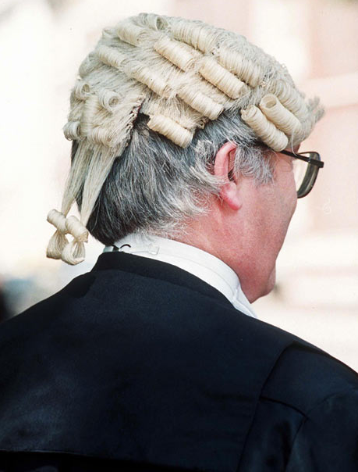
EPILOGUE
+
+
DOCTOR
ENGINEERS
LAWYER

Slide 57
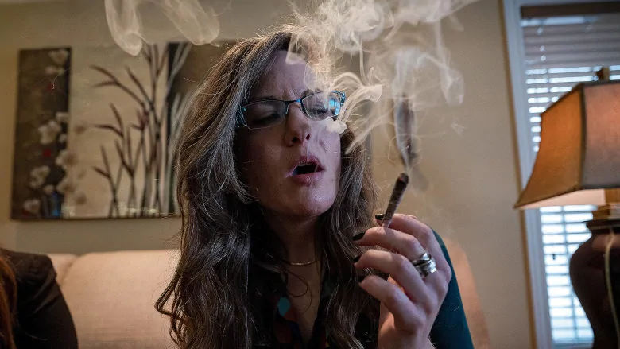
ADDENDUM Investor and employees in cannabis companies may be banned from entering U.S., report suggests
Official tells Politico that threat of lifetime ban on entering U.S. may extend to legal workers and investors
Pete Evans · CBC News · Posted: Sep 14, 2018 11:18 AM ET | Last Updated: September 15

Slide 58
Canadians who work in the cannabis industry face the prospect of being denied access to the U.S. even after recreational use becomes legal next month. (Evan Mitsui/CBC)
Shares in numerous TSX-listed marijuana companies were even more volatile than usual on Friday after an official at U.S. Customs and Border Protection said it's not just users of the drug who risk being refused entry to the United States — even people who work for and invest in the companies may too.

Slide 59
U.S. website Politico first reported on Thursday that even after recreational marijuana use becomes legal in Canada next month, the U.S. will continue to enforce rules concerning travel relating to the drug, which will continue to be a banned substance at the federal level even though numerous states have legalized it.

Slide 60
Pot companies on hiring spree ahead of lucrative legal market
"If you work for the industry, that is grounds for inadmissibility," Todd Owen of U.S. Customs and Border Protection (CBP) told Politico, adding that investors in cannabis from other countries have already been denied entry.
"Facilitating the proliferation of the legal marijuana industry in U.S. states where it is deemed legal or Canada may affect an individual's admissibility to the U.S.," Owen was quoted as saying.

Slide 61
Those who admit to using marijuana are likely to have the same level of scrutiny as before, but the report late Thursday suggested that the consequences may soon extend to those who work and invest in companies involved in the legal industry in Canada.
Canadians on track to spend almost $6B on pot this year — most of it the illegal variety

Slide 62
"As marijuana remains federally prohibited in the U.S., working or having involvement in the legal marijuana industry in U.S. states where it is deemed legal or Canada may affect an individual's admissibility to the U.S.," CBP told CBC News in a statement.
And lying to a border agent is itself enough to earn a lifetime ban, the agency says.
Annamaria Enenajor, a criminal lawyer and executive director of the Campaign for Cannabis Amnesty, said Friday that serious consequences are indeed something anyone crossing the border needs to know about.

Slide 64
A report in Politico on Thursday suggests that U.S. border officials may consider Canadians who work and invest in legal cannabis companies in Canada as being afoul of U.S. law. (Darryl Dyck/Canadian Press)
"If you have investments in cannabis companies, even companies that are publicly traded, that could raise flags," she said in an interview Friday.

Slide 65
While she says she doesn't expect border officials will start asking detailed questions on marijuana investments of everyone crossing the border, "if you're stopped at the border and you face questions about your involvement with cannabis, and you answer those questions in the positive, you can face a lifetime ban," she said.
Bill Blair, the minister of border security and organized crime reduction, told CBC News that although, "possession of cannabis is legal in some U.S. states, cannabis remains illegal under U.S. federal law" and Canadians travelling there need to respect U.S. laws.

Slide 66
He also warned that the U.S. has the right to set its own laws and that staff at the border are not amending their procedures to reflect the legalization of cannabis in Canada.
Canadians who wish to enter the United States or any other country have to adhere to its laws.

Slide 67
Cannabis marketers enjoy summer of schmooze ahead of legislative crackdown
The CBP statement suggests enforcement agencies will consider Canadians crossing the border on a case-by-case basis.
"CBP officers are thoroughly trained on admissibility factors and the Immigration and Nationality Act which broadly governs the admissibility of travellers into the United States," the agency said. "Determinations about admissibility are made on a case-by-case basis by a CBP officer based on the facts and circumstances known to the officer at the time."

Slide 68
But there's much uncertainty as to how far the concept of "involvement" the marijuana industry extends. Canadian Sam Znaimer was recently turned away and banned for life at a crossing in Washington state because one of his many business ventures is investment in U.S. cannabis companies.
ANALYSIS Profits and perils of the new Canadian pot economy: Don Pittis

Slide 69
His lawyer, Len Saunders, said Friday that the agency's latest comments came as a surprise to him since he had assumed the government would take a "hands off" approach to the drug once it was legal in Canada.
"Going forward, anybody involved in any cannabis industry, regardless of where it's located, regardless of whether or not it's legal in that state, province our country will be deemed inadmissible to the U.S.," Saunders said, adding that the news will have a "chilling effect" on legal businesses in Canada.
"Whether it's people who are just front-line workers, or investors, or running cannabis companies," he said, "if they find out you're involved, it's going to create a huge impediment on cross-border business and people."

Slide 70
Anyone hit with a ban can apply for a waiver to exempt themselves, which can be a costly and lengthy process. But if they plan to continue to be involved in the cannabis industry, there's no point anyway, Saunders says.
"If you get it approved and you're still involved in that industry, there's a very good chance you'll get it taken away," he said.
It's not immediately clear what level of involvement would constitute ownership in a marijuana company.

Slide 71
The three most active shares on the TSX on Friday were marijuana companies. The most active, Aurora Cannabis, saw more than 14 million shares change hands in the first hour of trading — more shares than were traded in all five big banks, and Rogers, Bell, Telus and Suncor put together.
As members of the main TSX index, marijuana companies such as Canopy Growth, Aphria, Aurora Cannabis and others are included in hundreds of mutual funds and ETFs, which means owners of those funds are technically investors in marijuana, too.

Slide 72
Shares in all those companies seesawed on Friday as gloom set in over the sector. All the big names plunged at open, before recovering later in the morning.
The two biggest pot companies — Canopy Growth and Aurora — saw their shares fall 14 and nine per cent, respectively, on Thursday, the day the Politico report came out.

Slide 73
CBP Statement on Canada’s Legalization of Marijuana and Crossing the Border
Release Date: September 21, 2018
UPDATED: 10/09/2018
U.S. Customs and Border Protection enforces the laws of the United States and U.S. laws will not change following Canada’s legalization of marijuana. Requirements for international travelers wishing to enter the United States are governed by and conducted in accordance with U.S. Federal Law, which supersedes state laws. Although medical and recreational marijuana may be legal in some U.S. States and Canada, the sale, possession, production and distribution of marijuana or the facilitation of the aforementioned remain illegal under U.S. Federal Law. Consequently, crossing the border or arriving at a U.S. port of entry in violation of this law may result in denied admission, seizure, fines, and apprehension.

Slide 74
CBP officers are thoroughly trained on admissibility factors and the Immigration and Nationality Act, which broadly governs the admissibility of travelers into the United States. Determinations about admissibility and whether any regulatory or criminal enforcement is appropriate are made by a CBP officer based on the facts and circumstances known to the officer at the time.
Generally, any arriving alien who is determined to be a drug abuser or addict, or who is convicted of, admits having committed, or admits committing, acts which constitute the essential elements of a violation of (or an attempt or conspiracy to violate) any law or regulation of a State, the United States, or a foreign country relating to a controlled substance, is inadmissible to the United States.

Slide 75
A Canadian citizen working in or facilitating the proliferation of the legal marijuana industry in Canada, coming to the U.S. for reasons unrelated to the marijuana industry will generally be admissible to the U.S. however, if a traveler is found to be coming to the U.S. for reason related to the marijuana industry, they may be deemed inadmissible.
CBP officers are the nation’s first line of defense in preventing the illegal importation of narcotics, including marijuana. U.S. federal law prohibits the importation of marijuana and CBP officers will continue to enforce that law.
U.S. Customs and Border Protection is the unified border agency within the Department of Homeland Security charged with the management, control and protection of our nation's borders at and between the official ports of entry. CBP is charged with keeping terrorists and terrorist weapons out of the country while enforcing hundreds of U.S. laws.
https://www.cbp.gov/newsroom/speeches-and-statements/cbp-statement-canadas-legalization-marijuana-and-crossing-border

